Slide 1
Color Image Processing

Slide 2
Outline
Color Fundamentals
Color Models
Pseudocolor Image Processing
Full-Color Image Processing
Color Transformations
Color Edge Detection
Color Segmentation
The noise in color images

Slide 3
Color Fundamentals
Two principal motivating factors for using color in image processing:
Color is a powerful descriptor that often simplifies object identification and extraction from a scene.
Humans can discern thousands of color shades and intensities, but just only two dozen of shades of grays.

Slide 4
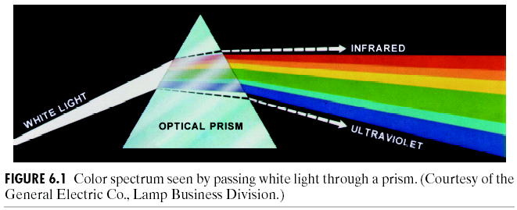
Seven bands in color spectrum:
Red, orange, yellow, green, cyan, blue, violet
The colors of object are often determined by the nature of the light reflected from the object, for example, green objects reflect light with wavelengths primarily in the 500 to 700 nm range.

Slide 5
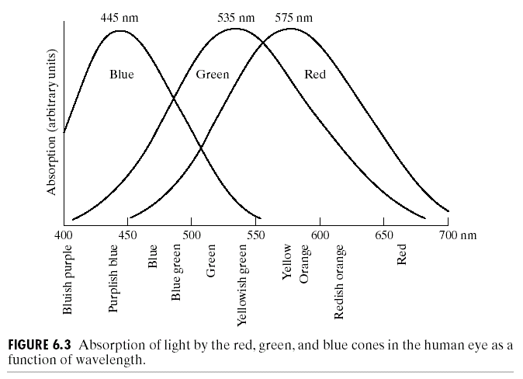
Color Fundamentals

Slide 6
Three primary colors designated by visual characteristics
Red (R), green (G) and blue (B), the wavelength specified by CIE is 700nm, 546.1nm and 435.8nm respectively.
Absorption experiment of color light of cones in human eye:
Blue
Green
Red
400 450 500 550 600 650 700nm
Bluish purple
Purplish blue
Blue
Blue green
Green
Yellowish green
Yellow
Yellow orange
Redish orange
Red
Notes:
CIE
CIE（Commission Internationale de L'Eclairage）：国际照明委员会，根据其法语名称简写为CIE。其前身是1900年成立的国际光度委员会（International Photometric Commission；IPC），1913年改为现名。总部设在奥地利维也纳。CIE制订了一系列色度学标准，一直沿用到数字视频时代，其中包括白光标准（D65）和阴极射线管（CRT）内表面红、绿、蓝三种磷光理论上的理想颜色。

Slide 7
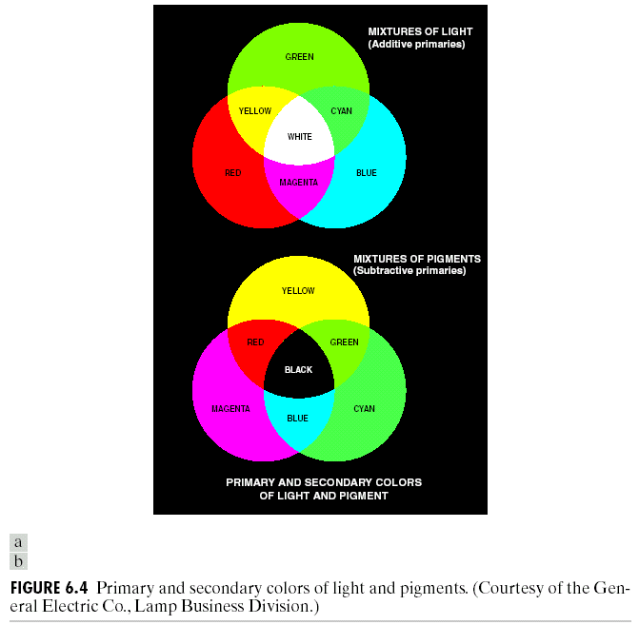
Additive nature
Secondary colors (the primary color of pigments or colorants) : magenta (red + blue), cyan (green + blue), and yellow (red + green)
Mixing the three primaries, will produces white light.
Mixing the three pigment primaries will produces black light.
Subtractive nature
Notes:
Secondary 混合色
Pigment 颜料 (colorant, 着色剂)

Slide 8
brightness, hue, saturation
Three characteristics generally used to distinguish one color from another are brightness, hue, and saturation.
Brightness embodies the achromatic notion of intensity.
Hue is an attribute associated with the dominant wavelength in a mixture of light waves and represents dominant color as perceived by an observer.
Saturation refers to the relative purity or the mount of white light (inversely proportional) mixed with a hue.
Hue and saturation taken together are called chromaticity.
Tristimulus value the amounts of red, green and blue needed to form any particular color, denoted by X, Y and Z, respectively.
Notes:
色调(Hue), saturation(饱和度), brightness(亮度), Tristimulus value(三色激励值):
Chromaticity 显色性（饱和度加色调）
所以，颜色就是亮度加显色性

Slide 9
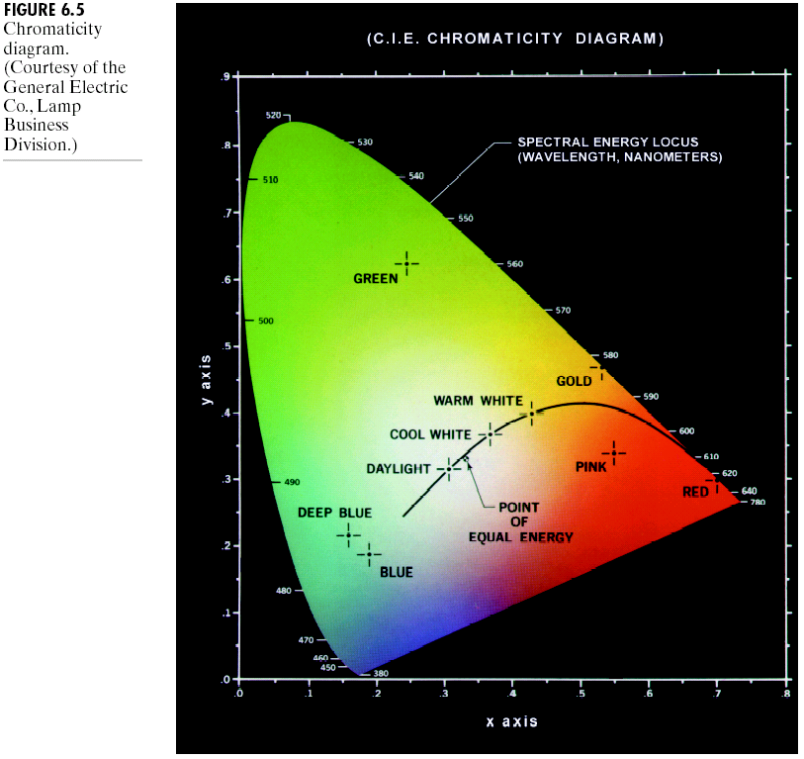
x (red) : 62%
y (green) : 25%
z (blue): z=1-x-y=13%
Approaches for specifying colors
1. Trichromatic coefficients
2. CIE chromaticity diagram (shows color composition as a function of x (red) and y (green) :
Notes:
这是一种颜色的描述方式，三色系数（理论上任何一个颜色可以由三个颜色的比例决定，即，任何三个颜色围成的三角区域内的任何一个点都可以三个点表达）
CIE的色度图，可以通过x，y的比例组合描述一种颜色（z也可得到）
舌状图的边缘是纯色（高饱和度），也表示了波长。越离开边界往中心靠近，越多白色加入，饱和度越低。
Trichromatic coefficients
三色系数

Slide 10
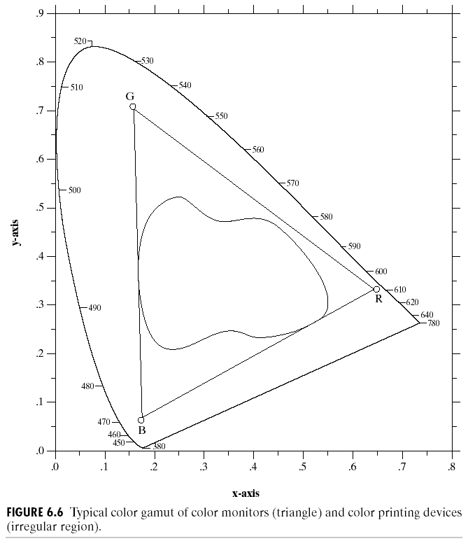
Color gamut of RGB monitor and color printing device
The color gamut of RGB monitor
The color gamut of high quality color printing devices
From triangle with three fixed colors as vertices we can observe that not all colors can be obtained with three fixed primaries.
Notes:
Color gamut (域）

Slide 11
Color image processing includes two major areas
1. Full-color: the images in question typically are acquired with a full-color sensor, such as a color TV camera or scanner.
2. Pesudo-color processing: assigning a color to a particular monochrome intensity or range of intensities.

Slide 12
Outline
Color Fundamentals
Color Models
Pseudocolor Image Processing
Full-Color Image Processing
Color Transformations
Color Edge Detection
Color Segmentation
The noise in color images

Slide 13
Color Models
Purpose：
To facilitate the specification of colors, to quantitatively describe colors, usually can be classified as:

Slide 14
Hardware-oriented:
RGB: for color monitors and a broad class of color video cameras;
CMY (or CMYK: cyan, magenta, yellow and black): color printing;
Application-oriented:
HSI (hue, saturation and intensity): corresponds closely with the way humans describe and interpret color. It also decouples the color and gray-scale information, making it suitable for many of the gray-scale technique.

Slide 15
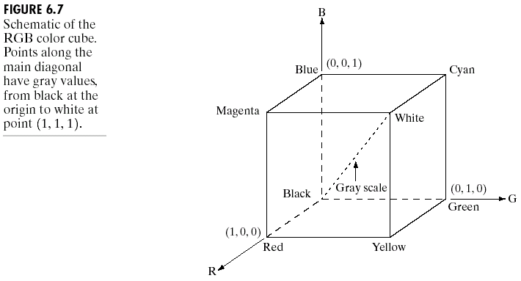
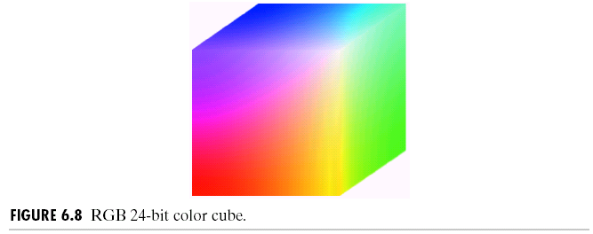
RGB color model
Bit depth (or pixel depth): the number of bits used to represent each pixel in RGB space.
Full color: 24-bit RGB color image. The total of colors is (2⁸)³= 16,777,216.
Notes:
左图：各个顶点的含义；白、黑点，连线
右图是做图案填充后的立方体

Slide 16
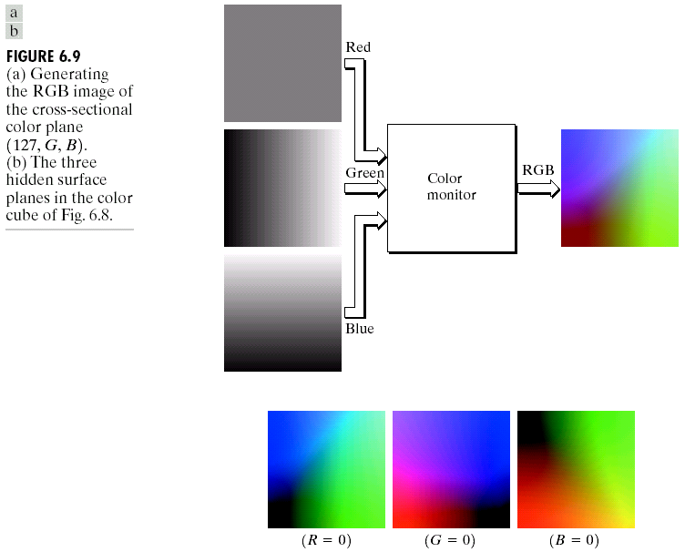
Generating the RGB image of the cross-sectional color plane (127, G, B)
Three hidden surface planes in the color cube
Notes:
做一个立方体的截面可以很好的观察立方体的内部
上组图为R=127的截面
下图为三个隐藏面
彩色图像的获取过程与上图相反：三个传感器，分别对RGB三个通道敏感。在显示时，如果是灰度图像，则是单独一个通道的图像，强度与获取的单通道的图像成比例。

Slide 17
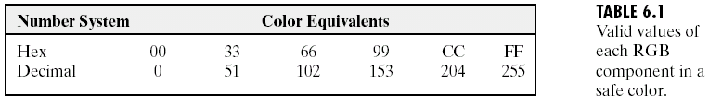
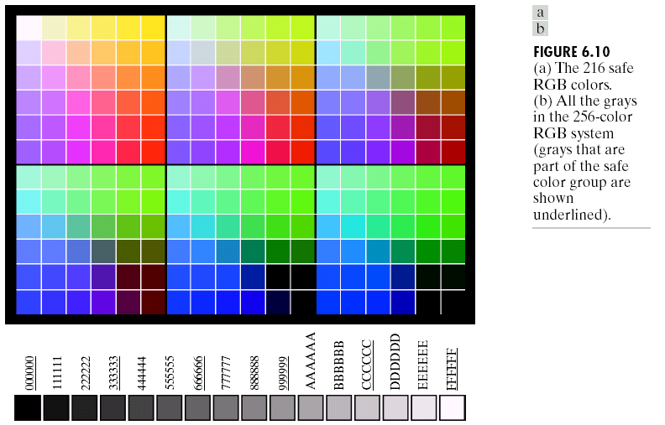
Organized in descending RGB values.
For most graphics images used for Internet applications, a set of 216 colors has been selected to represent "safe colors" which should be reliably displayed on computer monitors.
Notes:
之前的RGB的表达方式是基于显卡的性能的假设。如果没有足够的显卡性能，其他的表达方式。
256色是已知的安全的的颜色种类（可被大多数的系统识别），鉴于某些系统对于其中的40中颜色的处理模式不一样，所以通常的安全现实方式是保留216的显示方式。
使用的方式是三个分量只能为图6.1中的值。6^3=216

Slide 18
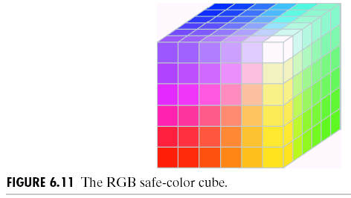
It is a hollow cube, that is to say, it has valid colors only on the surface planes.

Slide 19
CMY and CMYK Models
An RGB to CMY conversion
CMYK – cyan, magenta, yellow, and black. This model is used in connection with generating hardcopy output.
Notes:
常用于打印中，这是一个减色处理（白色到其他颜色）
相对于RGB是一个增色的过程，从黑色到其他颜色

Slide 20
HSI (hue, saturation, and intensity) Model
HSI model decouples the intensity component from the
color-carrying information (hue and saturation). It is an
ideal tool for color description that are natural and
intuitive to humans.
H: Hue
A color attribute that describes a pure color
S: Saturation
A measure of degree to which a pure color is diluted by white light
I: Intensity

Slide 21
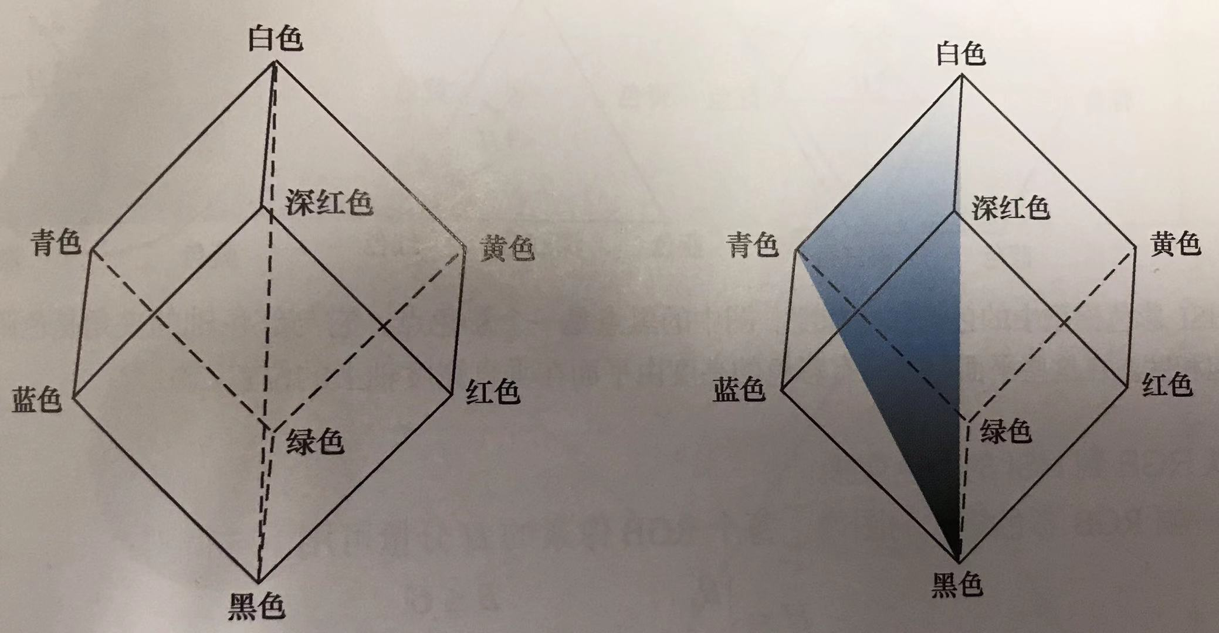
Relationships Between RGB and HSI Models
Notes:
I 分量的确定方法：
左上角是之前的坐标轴，注意黑和白色点的位置
将黑色放在下，白色放在正上方，任何一个点做一个与该轴垂直的平面，交点就为I
H分量的确定方法：
观察青色和白色以及黑色的连接面。如果按照之前的三色原理，这里除了青色之外不会有别的颜色，所以H就是这样确定的，

Slide 22
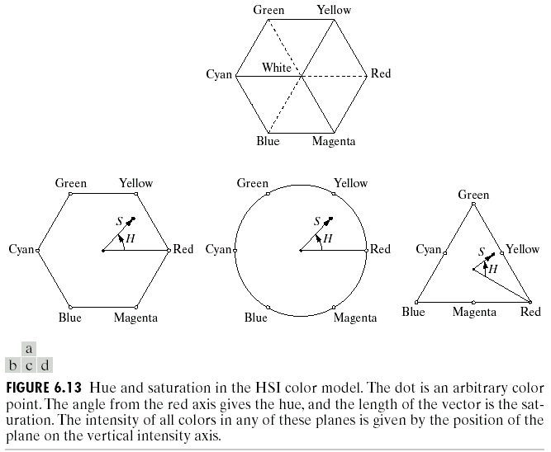
Relationships Between RGB and HSI Models
Several other forms of HSI Models
Notes:
从刚才的立方体的底端出发，延黑白轴移动截面，会出现三角形或者六边形，以六边形为例：
一个点（颜色）的定义为H为角度，S为长度。 角度为顺时针方向。

Slide 23
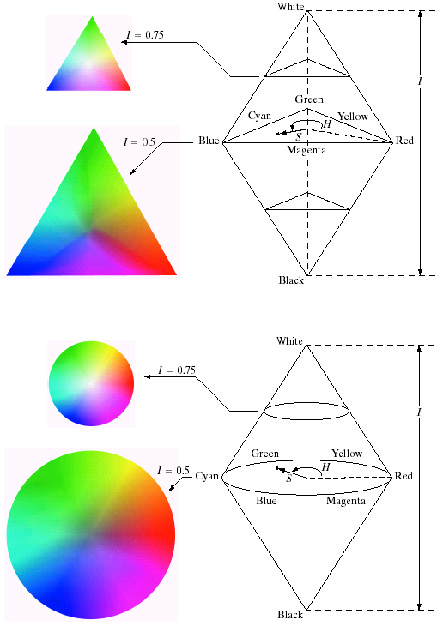
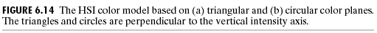
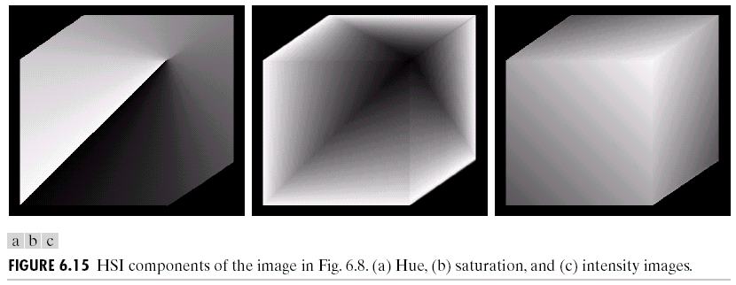
Several other forms of HSI Models
Notes:
H图中对角线的原因：从左图红色点到白色点连一条线，中间选一个点，从该点沿着平面移动，直到回到出发点，会发现沿路经过色调为黄、绿、青 蓝 品蓝再回到红色，根据之前的H的定义图，这一过程H是从0增加到360度
S图代表从白色到黑色，代表越接近白色区域，饱和度越小（更多白色加入）
最后一个I表示各个点上的强度一致。

Slide 24
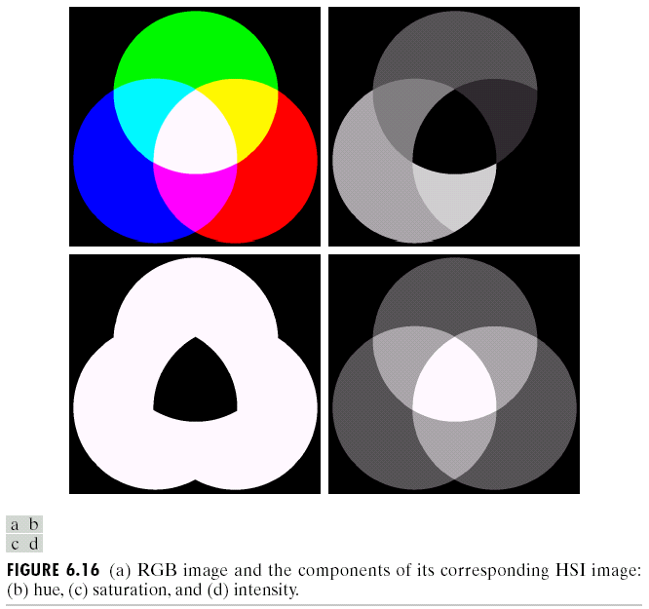
Notes:
H图中，注意白色和红色的色调是一致的
S图中，中心区域为低饱和度（白色）

Slide 25
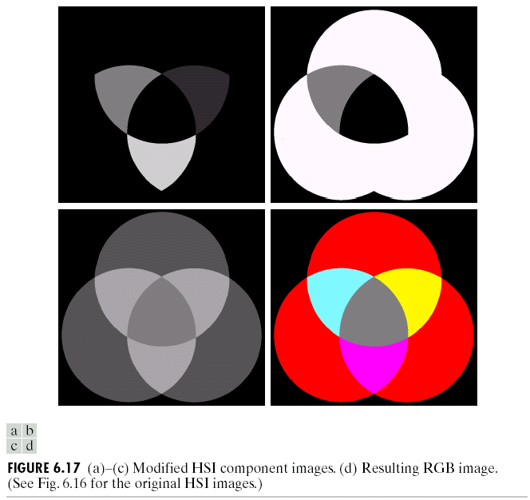
Manipulating HSI components images
Hue component and change to 0 the pixels corresponding to the blue and green region in Fig.6.16(b)
Saturation component and reduce by half the saturation of the cyan region in Fig.6.16(c)
Intensity component and reduce by half the intensity of the central white region in Fig.6.16(d)
The modified result image
Notes:
第一幅图将蓝色和绿色区域变为0 （H变为0对应图将变为红色）
品蓝饱和度降低一半
强度降低一半

Slide 26
Conversions From RGB To HSI
R, G, B , S, I values have been normalized to the range [0, 1]. H can be normalized to [0, 1] by dividing by 360°, and the angle theta is measured with respect to the red axis of the HSI space.

Slide 27
Conversions From HSI To RGB
RG sector (0<=H<120°)
GB sector (120°<=H<240°)
H=H-120°
BR sector (240°<=H<360°)
H=H-240°

Slide 28
Outline
Color Fundamentals
Color Models
Pseudocolor Image Processing
Full-Color Image Processing
Color Transformations
Color Edge Detection
Color Segmentation
The noise in color images

Slide 29
Pseudocolor Image Processing
Concerns the assignment of colors to gray values
Purpose: Better human visualization and interpretation
Why: Humans can discern thousands of color shades compared to only two dozen or so shades of gray
Intensity slicing
Gray level to color transformations
(generate color map based HSI model and covert it to RGB and display the pseudocolor image)

Slide 30
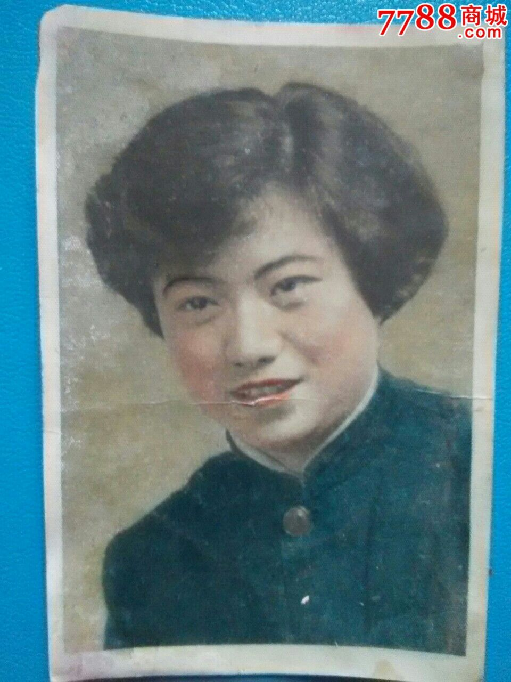
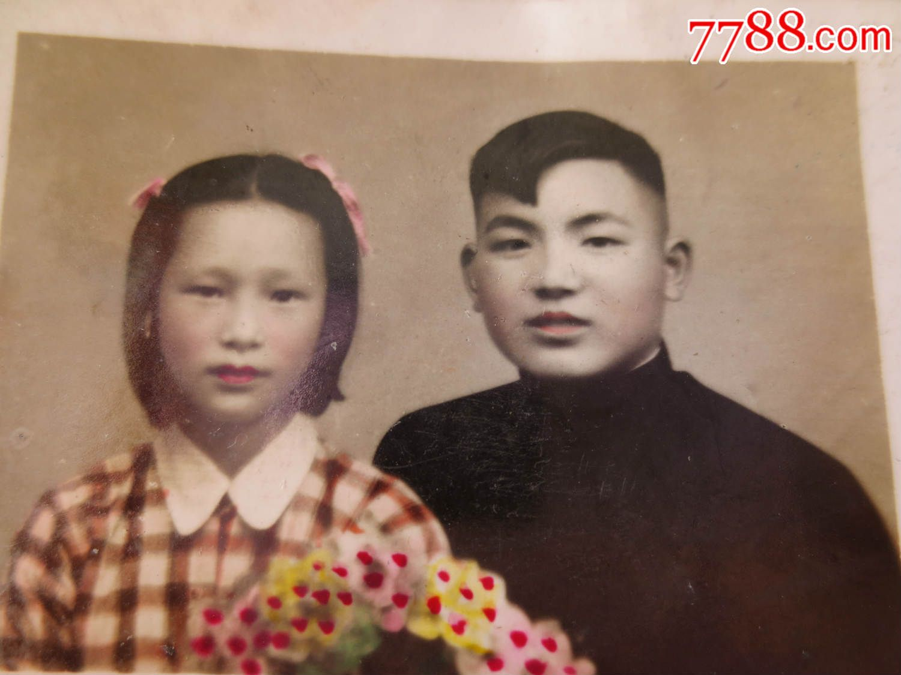
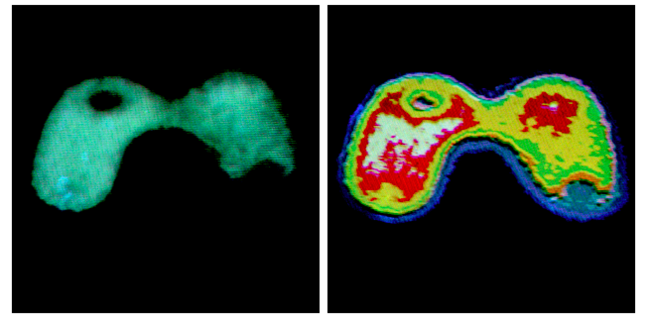

Slide 31
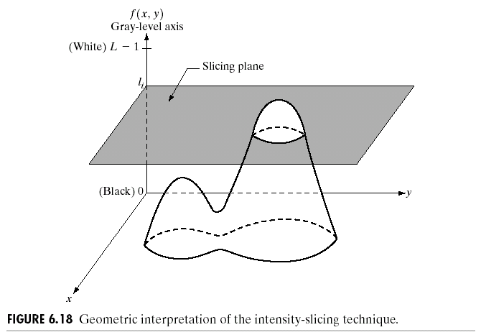
Intensity Slicing
Treat an image as a 3D function
Notes:
图像的三维函数表示。
可以沿灰度轴均匀设置分割面，分割面经过的像素，赋予一个特定的颜色值。

Slide 32
Pseudocolor Image Processing- Intensity Slicing and color coding
The pseudo- (or false-) colors used to colorize a gray level image do not represent the original, true colors if there were originally a color image. One of the principal motivations for using false-color is the fact that humans can discern thousands of color shades and intensities, compared to only two dozen or so shaded of gray.

Slide 33
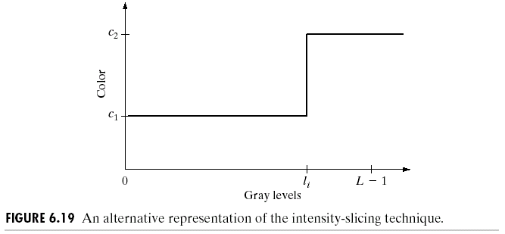
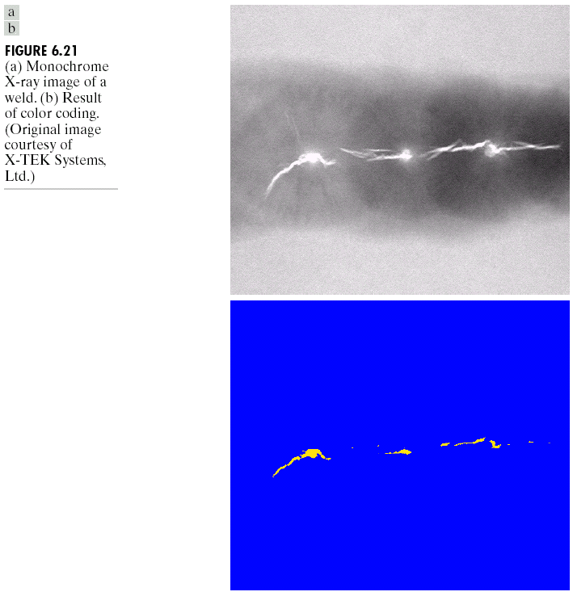
Assign one color to the brightest gray-level and another to all other gray levels.
Pseudocolor Image Processing for the visual inspection of weld crack, the human error rates would be lower.
Notes:
A weld 焊接

Slide 34
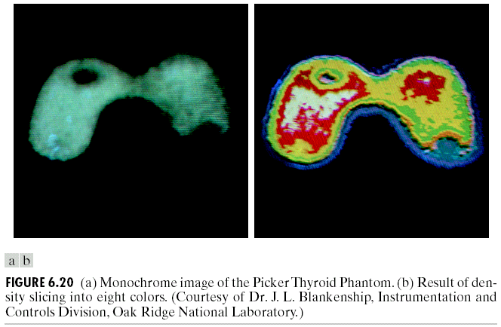
Pseudocolor Image Processing Intensity Slicing
Notes:
Picker Thyroid Phantom; Picker甲状腺模型

Slide 35
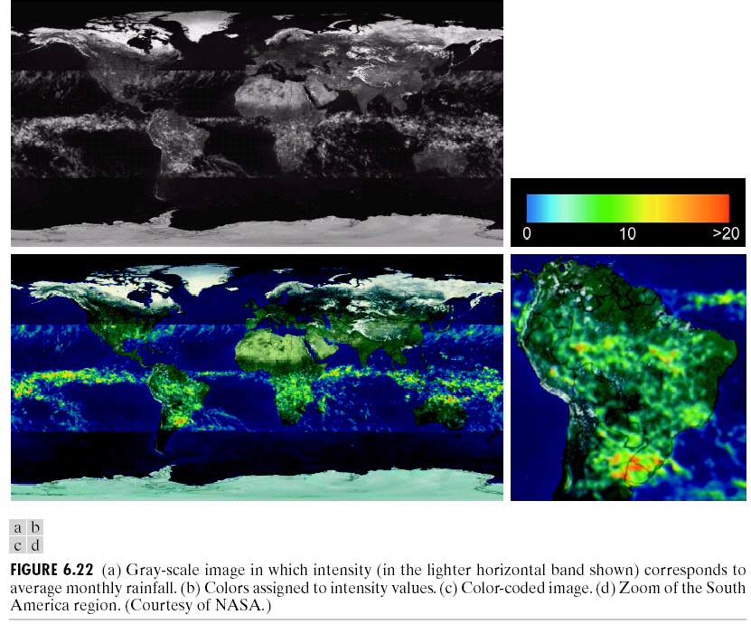
Pseudocolor Image Processing for rainfall detection
Each pixel in these images represents a physical land area whose size depends on the resolution of the sensors.
Notes:
rainfall 降雨

Slide 36
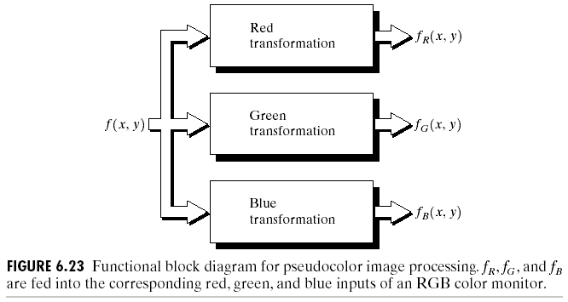
Gray Level to Color Transformations
Gray level to color transformation for achieving a wider range of pseudocolor enhancement results.
Through three independent transformations
Notes:
灰度转化法是设置三个独立的转化函数，将灰度值分别转化为RGB三个通道的值，最后通过显示器或者颜色模型等方法，合成彩色。

Slide 37
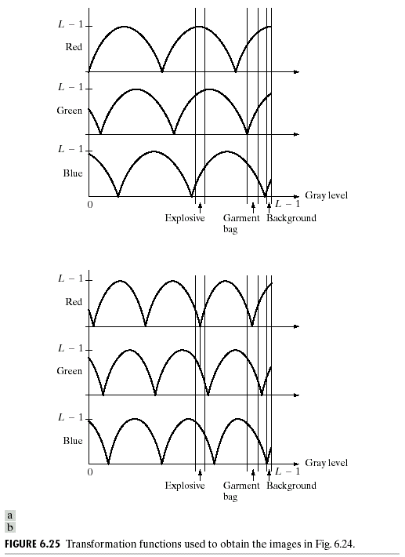
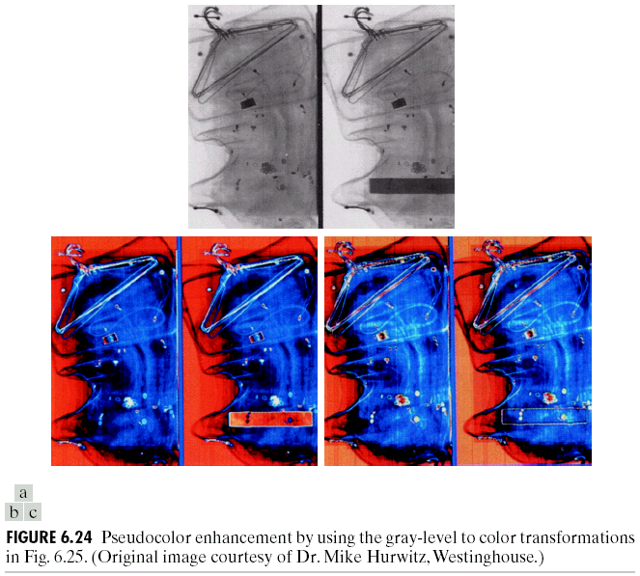
Two types of transformation functions
X-ray scanning images
Notes:
上面的灰度图，左图为正常物品，右图多了一个模拟的塑料炸弹。
b图中，虽然炸弹与背景灰度差异很大，但是被转化为基本相同颜色
c图中，炸弹和garment bag（衣服保护袋）基本一个颜色，虽然灰度差异很大。就会造成漏看
不同的相位和频率可以产生不同的转化函数。如果相位和频率相同的话，将产生灰度单色吞。

Slide 38
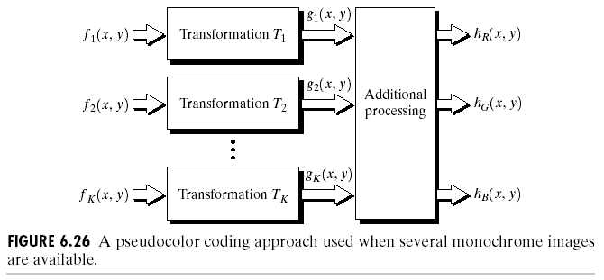
Gray level to color transformation used in multi-spectral image processing
It is often of interest to combine several monochrome images (which are formed by different spectrum band) into a single color composite.
Notes:
另外一种办法是使用多种单色图进行颜色的合成（比如多个传感器从不同频段获得的图像的合成）

Slide 39
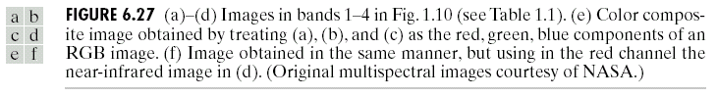
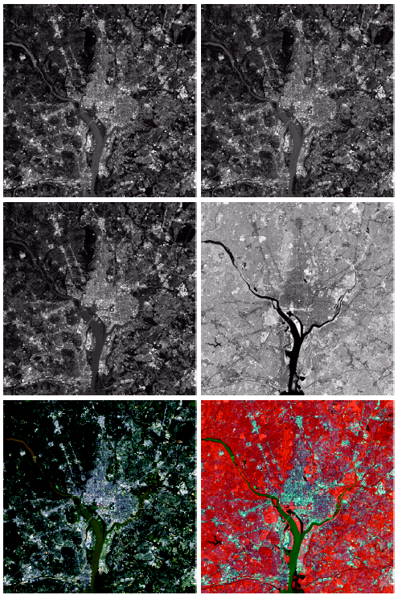
(a)
(b)
(a)-(d) show four spectral satellite images: red, green, blue, and near-infrared. (e) is the full-color image obtained by combining the first three images into a RBG image. (f) is the combination of (a), (b) and (e). Notation: near-infrared band is strongly responsive to the biomass components of a scene.
(c)
(d)
Potomac River
(e)
(f)
Notes:
Photomac 波托马克河
f图是叠加了近红外图像d，大多数红外成像是跟人的活动有关系的，所以可以一定程度上反应人的一些活动特性。
接近蓝色的区域是柏油马路。
这对于可视化是有很大的帮助。

Slide 40
Outline
Color Fundamentals
Color Models
Pseudocolor Image Processing
Full-Color Image Processing
Color Transformations
Color Edge Detection
Color Segmentation
The noise in color images

Slide 41
Full-Color Image Processing
Color Transformations
Color Complements
Tone Correction
Color Correction
Histogram Processing
Spatial processing
For individual color component
Color vector processing
Gray level transformations
Image negatives
Log, power law,…
Histogram equalization
Spatial processing
Spatial filtering, edge detection, segmentation…

Slide 42
Full-Color Image Processing
Two processing methods:
(1) process each channel (or color component) separately, as if the color image were three gray scale images;
(2) work with color pixels directly represented as a vector and process all channels with each pixel.

Slide 43
Full-Color Image Processing
In order for per-color-component and vector-based processing to be equivalent, two conditions have to be satisfied
The process has to be applicable to both vectors and scalars.
The operation on each component of a vector must be independent of the other components.

Slide 44
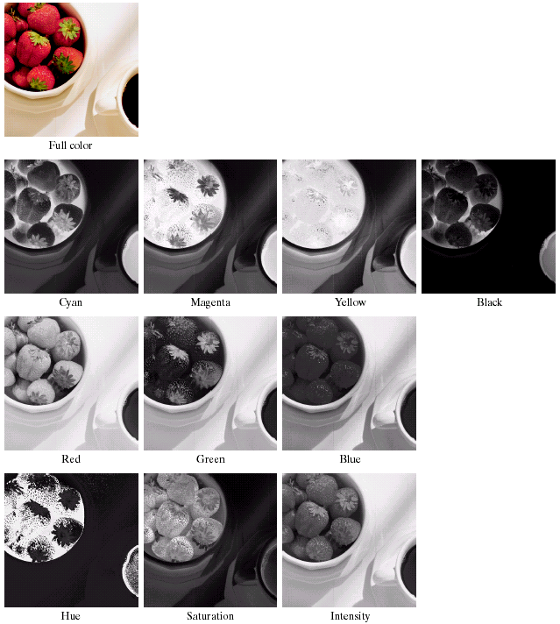
Notes:
这组图中能够看到各个分量值的比例
比如红色多，黄色多或者绿色多。
HSI中的H可以看到轴的值得不连续，比如红色区域里有大量黑色的区域。

Slide 45
Outline
Color Fundamentals
Color Models
Pseudocolor Image Processing
Full-Color Image Processing
Color Transformations
Color Edge Detection
Color Segmentation
The noise in color images

Slide 46
Color Transformations
As apposed to gray-level transformation
General expression
Selection of color model and color component(s) to work on
For modifying intensity, HSI model is preferred
For HSI model, only one component (I) is to be modified
For RGB model, all components are to be modified
Notes:
T 变换函数
S 变换后的数值 r1,r2,….是各分量，比如rgb模型，n=3
理论上任何一个变化可以施加于任何一个颜色模型中的，但是在实际操作中，还是根据变换选择表示模型（模型转化代价较低）见书公式6.5.3-6.5.6

Slide 47
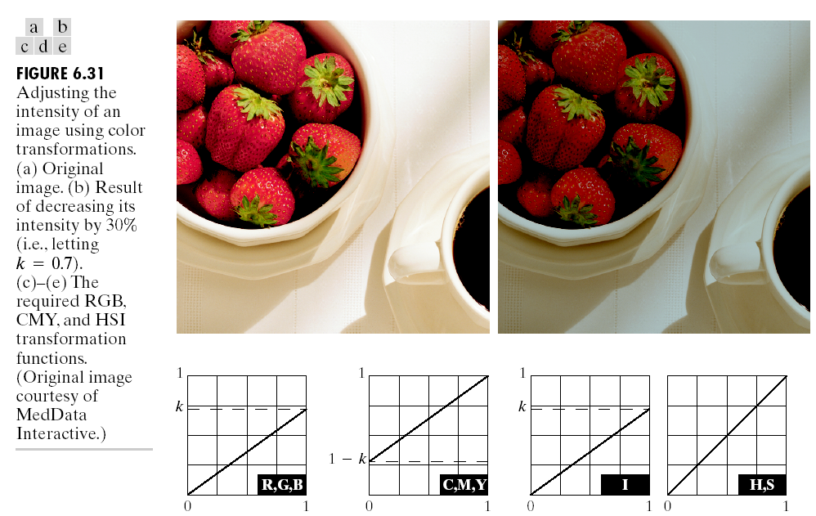
Color Transformations
Color Transformations
RGB<->HSI<->CMYK

Slide 48
Color Complements Transfer
To the human visual system, colors have complements.
Complements are basically given by subtracting one color from white, or by changing a hue by 180 degrees.
Complements are useful for enhancing detail that is embedded in dark regions of a color image.
Notes:
Complements 补色现象
为了减轻长时间看一种颜色产生的疲劳，视神经会诱发一种补色进行自我调节。
例如：长时间对着鲜血的手术医生来说，偶尔转看白大褂或者墙面会产生绿色的幻象，从而影响手术质量。
所以手术时采用浅绿色大褂和墙面可以避免这一情况。
色相盘上对面的颜色叫做补色。
补色残像就是由于视觉的暂留效应，而产生看到补色的效果的现象。色相环
简单的说就是将两种颜色混合一下，可以看到黑色系的颜色（包括各种灰色，白色），那这两种颜色就互为补色。
在绘画时使用补色可以是画面更协调更舒服。一般，红配绿，蓝配橙，黄配紫。

Slide 49
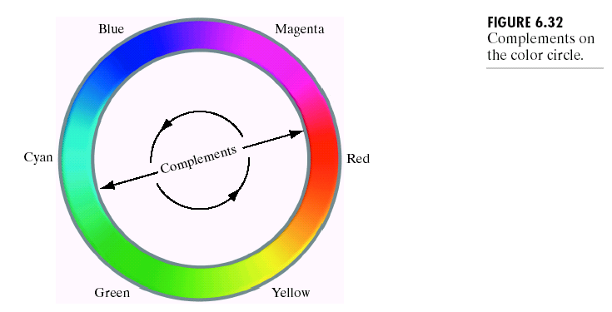
Color Complements Transfer
Implementation using RGB model
Implementation using HSI model
Notes:
Color Complements 补色
一个色环可以很好的解释补色的计算方式。
HSI空间的操作并不像RGB空间一样直观，可以自己推倒

Slide 50
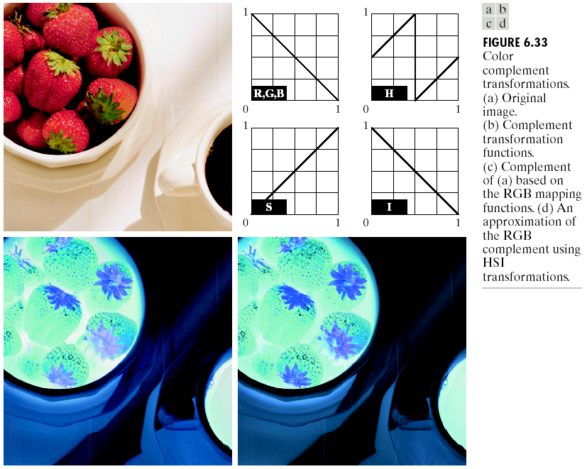

Slide 51
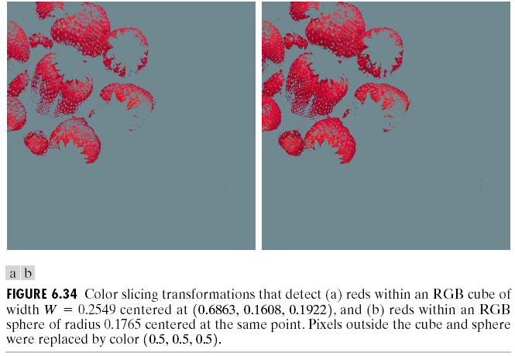
Color Slicing
Color slicing: highlighting a specific range of colors in an image. Two methods: cube- and sphere-based methods.
Notes:
颜色分层的作用：
1.可以凸显特定颜色的区域
2.可以对特定颜色进行处理
Sphere 球体

Slide 52
Tone and Color Corrections Tone Corrections
Device-independent color model
CIE L* a * b * model (CIELAB): colorimetric, perceptually uniform, and device independent.
L* represents brightness, a* for red minus green, and b* for green minus blue;
CIE model is useful in both image manipulation (tone and contrast editing) and image compression applications.
Tonal range, also called its key type, refers to its general distribution of color intensities.
The correction of tonal and color imbalances.
Notes:
一种与设备无关的表达方法很重要，因为设备对于颜色的表示是有误差的
LAB的表达方式与HSI一样，是将亮度和颜色分开处理。
Key type high type是强度较强，low type是强度较弱，middle type是中间位置
一般我们期望和灰度图像一样，强度是均匀分布的。

Slide 53
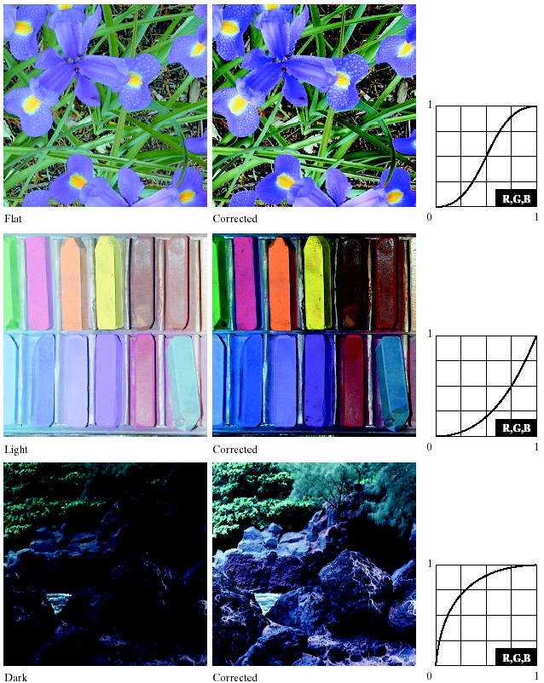
Tonal Correction
The highlight and shadow area were lightened and darkened, respectively
It corresponds to the enhancement of gray-level images using gray level transformations.
Modifying image tones is done by adjusting the image’s brightness and contrast.
Notes:
图像色调的调整，通常是指交互式的调整图像的亮度和对比度，通过经验，选择合适的调整策略。
对RGB和CMY而言，同时调整所有通道
HSI只调整一个I通道就可以了。

Slide 54
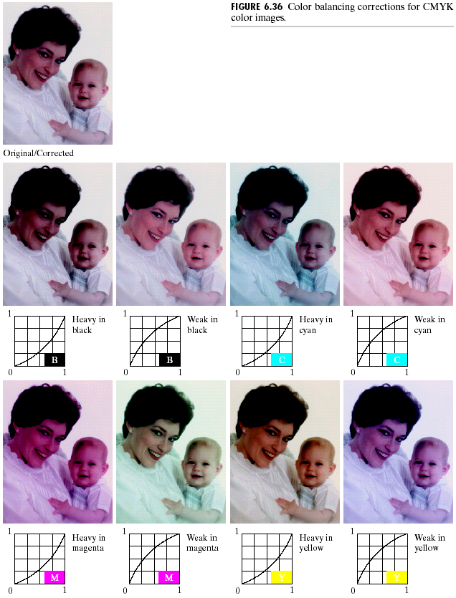
Color Correction
Used to correct any color imbalance
Done experimentally by adjusting each of the color components
Analyzing a known color using a color spectrometer
Visually assess skin color

Slide 55
Histogram processing
Histogram processing is performed on the intensity component only (HSI model)
O.W. the colors are altered
Histogram processing is often followed by saturation adjustment (increasing saturation).

Slide 56
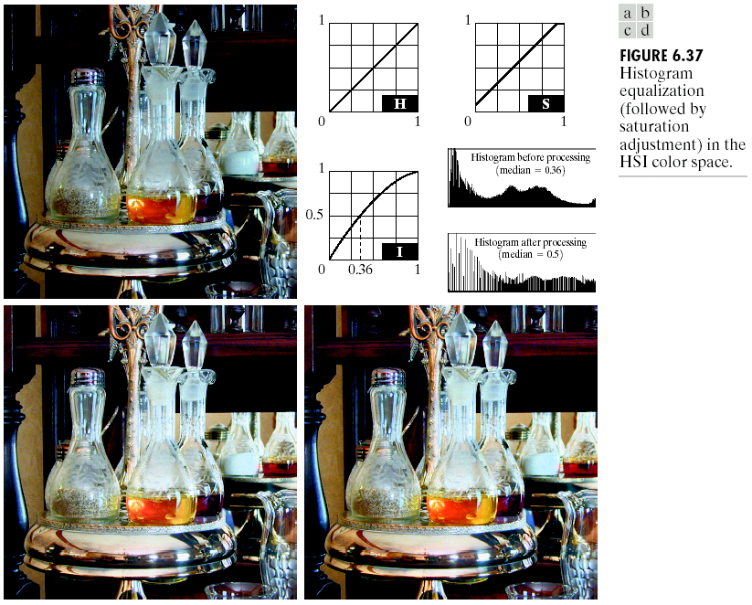
Notes:
c没有调整饱和度
d调整饱和度 （调料瓶中的醋和油有所变化）
虽然颜色没有调整，但是亮度的变化会导致颜色的感知有变化
通常亮度调整会随饱和度一起调整。

Slide 57
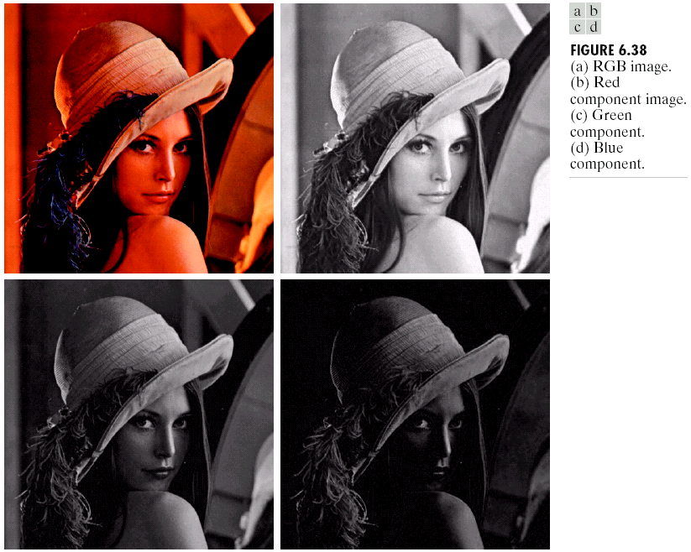
Spatial Filtering of Color Images
Linear filtering technique can be applied on individual color component or all of the color components at a time.
Usually is performed on all of the three RGB components.
Smoothing by neighborhood averaging can be carried out on a per-color-plane basis.
Result is similar to performing on the intensity component only using HSI model.

Slide 58
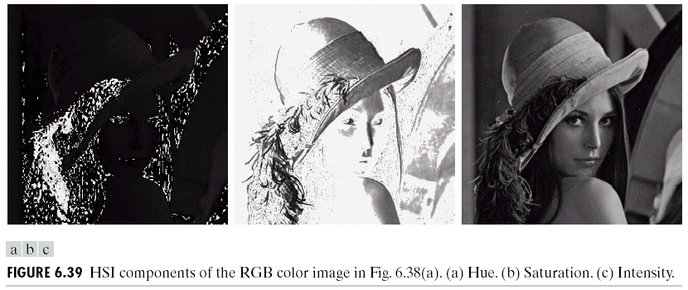
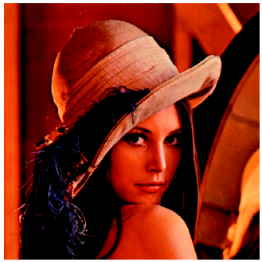
Color Image Smoothing and Sharpening

Slide 59
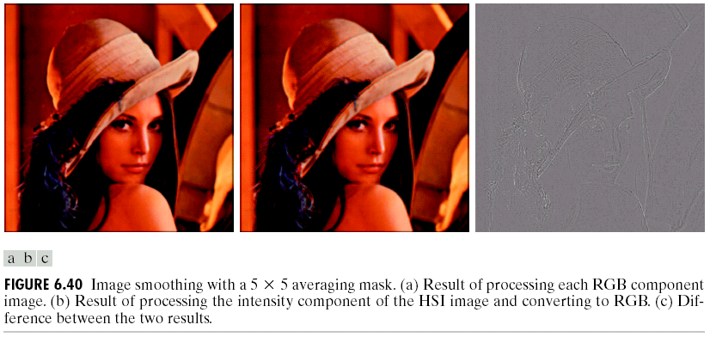
Color Image Smoothing and Sharpening
Notes:
两幅图分别两种操作模式
从差图看还是有差别的，原因：分析下做的方式（RGB上做均值和I通道做均值，后者没有改变颜色）
随着mask变大，差别也更明显

Slide 60
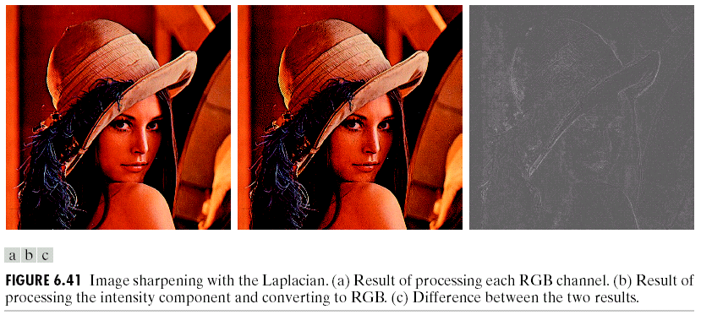
Color Image Smoothing and Sharpening
Laplacian method: see Section 3.7.2 (Pages 128-131)

Slide 61
Outline
Color Fundamentals
Color Models
Pseudocolor Image Processing
Full-Color Image Processing
Color Transformations
Color Edge Detection
Color Segmentation
The noise in color images

Slide 62
Color Edge Detection
Many edge detection operators are derived from approximating gradients like Sobel and Prewitt operators.
One way to perform color edge detection is to apply edge detection operators on individual color plane and combine the results.
Alternatively, we can generalize the idea of gradient to vectors and derive similar operation for vector valued functions (color image)
In general, the edge detection is more stronger and complete in the latter case
Notes:
在空域图像的锐化中，可以做边缘检测（没有展开细讲）

Slide 63
color edge detection
Edge detection is a important tool for image segmentation. The gradient discussed in Section 3.7.3 is a method of edge detection of gray-scale image, but can’t be defined for vector quantities. Thus, computing the gradient on individual image and then using the result to form a color image will lead to erroneous. Obviously we need a new definition of the gradient applicable to vector quantities.

Slide 64
Generalization of Gradient to Vector Valued Functions
Let r, g, b be unit vectors along the R, G and B axis of RGB color space, and define the following two vectors:

Slide 65
Generalization of Gradient to Vector Valued Functions
Let the quantities g_{xx}, g_{yy}, and g_{xy} be defined in terms of the dot product of these vectors, as follows (Di Zenzo[1986]) :

Slide 66
Generalization of Gradient to Vector Valued Functions
It can be shown that the direction of maximum rate of change of c(x,y)=(R(x,y), G(x,y), B(x,y)) is given by the angle
and the value of the rate of change at (x, y) in the direction of Ө is given by
Notes:
这个导数形式可以由一个mask实现，比如sobel mask

Slide 67
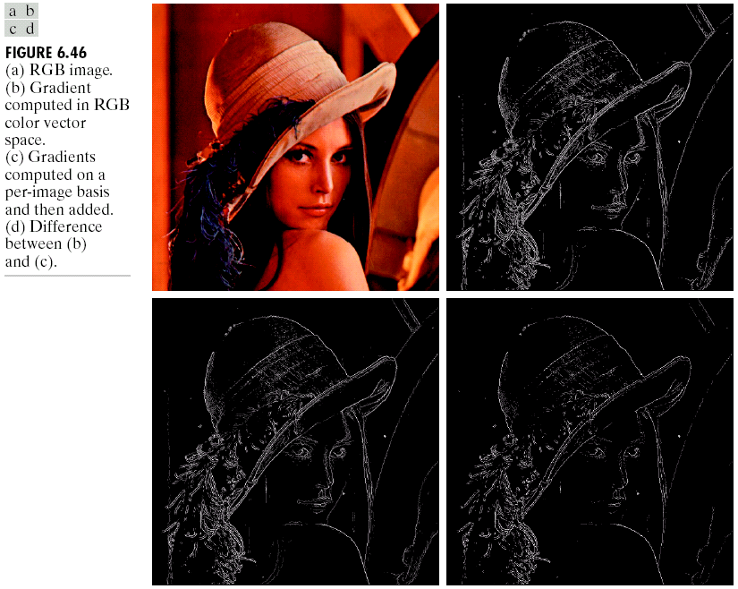
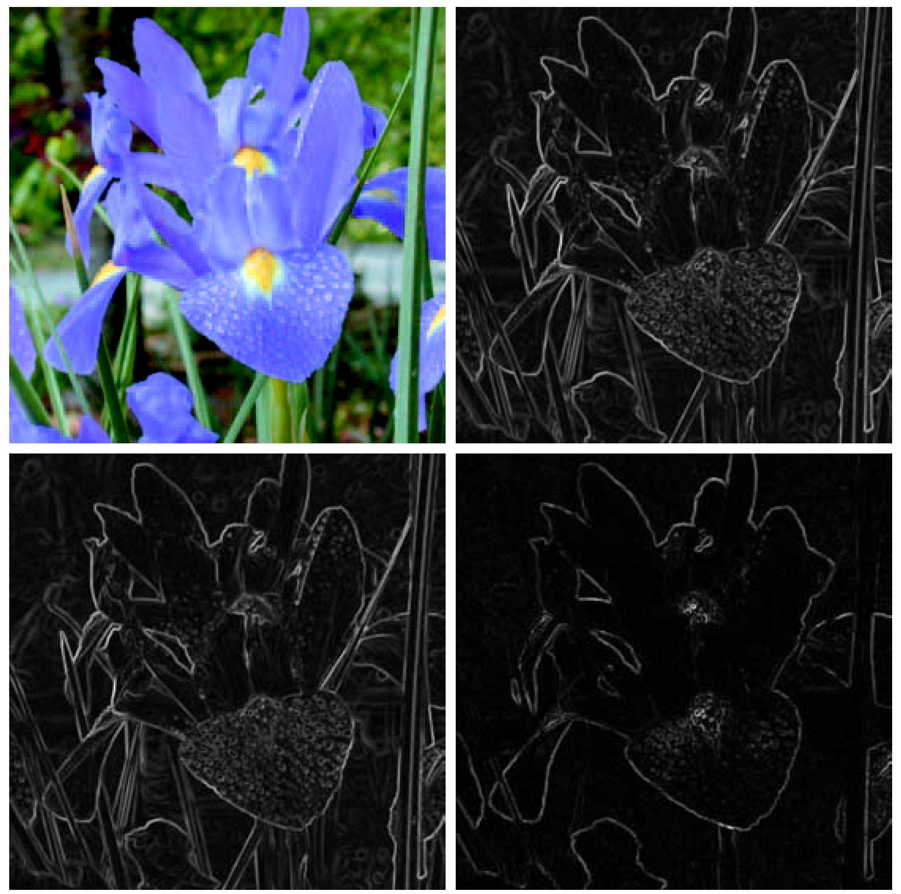
Color Edge Detection
Notes:
两个方法得到的边缘都是合理的，具体问题具体对待

Slide 68
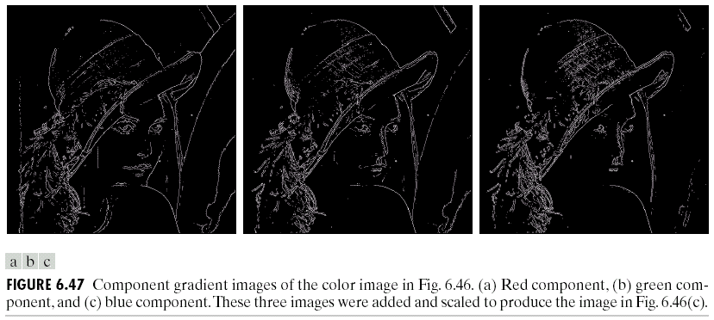

Slide 69
Outline
Color Fundamentals
Color Models
Pseudocolor Image Processing
Full-Color Image Processing
Color Transformations
Color Edge Detection
Color Segmentation
The noise in color images

Slide 70
Color Segmentation
Color segmentation can be done in either RGB model or HSI model
The goal is to segment regions with similar colors defined by the user.
The general approach is the following
Choose a prototypical color c with components (c₁,…, c_{n} )
Define a distance measure D between two colors a and b.
If D(c, a)<T, keep the original color, o.w, assign a nonprominent neutral color. T is a predefined threshold.

Slide 71
Color Segmentation in RGB Vector Space
The prototypical color c can be determined by a set of sample color points representative of a color of interest through the mean vector (m) of the samples.
If the Euclidean distance is used, we have

Slide 72
Color Segmentation in HSI Vector Space
If HSI model is used, the definition of D should involve H component only.
Saturation is often used as a masking image to isolate further regions of interest in the hue image
Pixels with the same hue but very low saturation appear to be quite different in color (whitish)

Slide 73
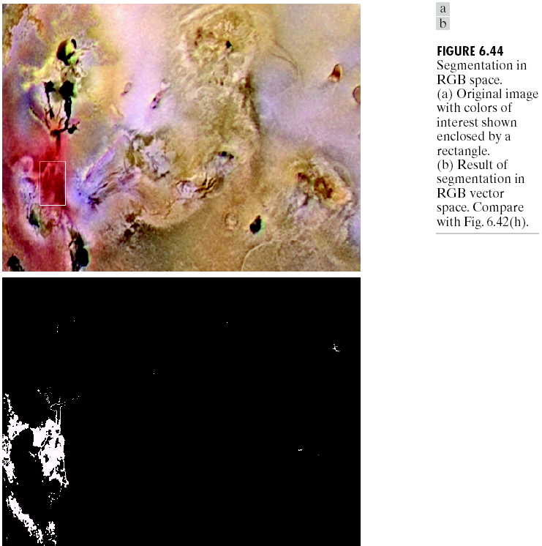
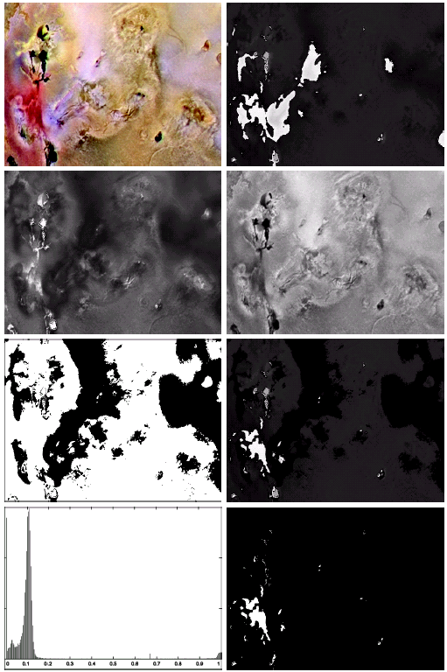

Fig6.44b Yield much more accurate results compared to HIS (correspond much more closely with what we would define as “reddish”
Notes:
6.44使用了RGB空间的距离度量（度量方法见书468
页）
6.42e是用制造了一个mask，饱和度在最大饱和度10%范围内的

Slide 74
Color Segmentation in RGB Vector Space
The Euclidean distance can be generalized as (Mahalanobis distance)
C is a symmetric matrix that controls the shape of the enclosed region, z and m are vectors.
C is often chosen as the covariance matrix of the samples that are representatives of the color to be segmented.
The locus of points such that D(z, m)<T describes a solid 3D elliptical body with the property that its principal axes are oriented in the direction of maximum data spread (variance).
Notes:
Mahalanobis 马氏距离
马氏距离(Mahalanobis distance)是由印度统计学家马哈拉诺比斯(P. C. Mahalanobis)提出的，表示数据的协方差距离。它是一种有效的计算两个未知样本集的相似度的方法。与欧氏距离不同的是，它考虑到各种特性之间的联系（例如：一条关于身高的信息会带来一条关于体重的信息，因为两者是有关联的），并且是尺度无关的(scale-invariant)，即独立于测量尺度。对于一个均值为μ，协方差矩阵为Σ的多变量向量，其马氏距离为sqrt( (x-μ)'Σ^(-1)(x-μ) )。

Slide 75
Outline
Color Fundamentals
Color Models
Pseudocolor Image Processing
Full-Color Image Processing
Color Transformations
Color Edge Detection
Color Segmentation
The noise in color images

Slide 76
The noise in color images
Different noise levels are more likely to be caused by differences in the relative strength of illumination available to each if the color channels CCD sensors are noisier at low level of illumination
Intensity component is slightly smoother than any of the three noisy images (because intensity image is the average of the RGB images)

Slide 77


Slide 78


The noise in color images
Fig. 6.48(d)

Slide 79

Noise in Color images
The noise of one RGB channel can be spread to all HSI channel when converting the RBG model to HSI model.

Slide 80
Summary
Color fundamentals
Color models
Pseudo-color and full-color processing
Color vector space
Color edge detection

